Slide 1

RUNNING SIGNAL
TRANSPORTATION guide
August 27
Crafted by Beau King | Newsletter

Slide 2



Slide 3
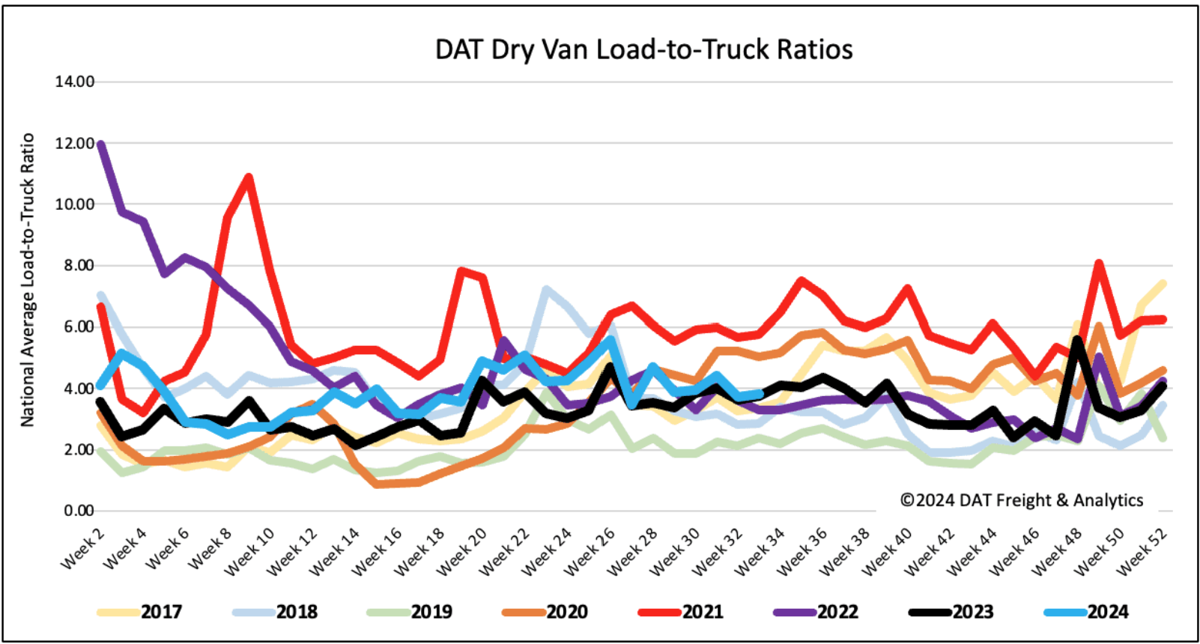
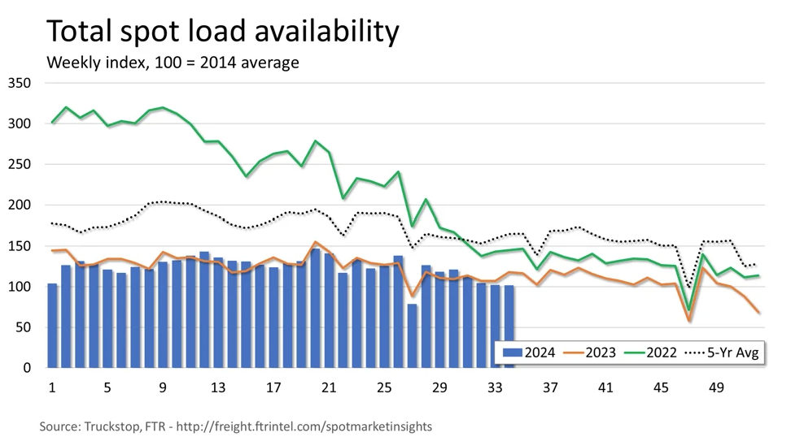
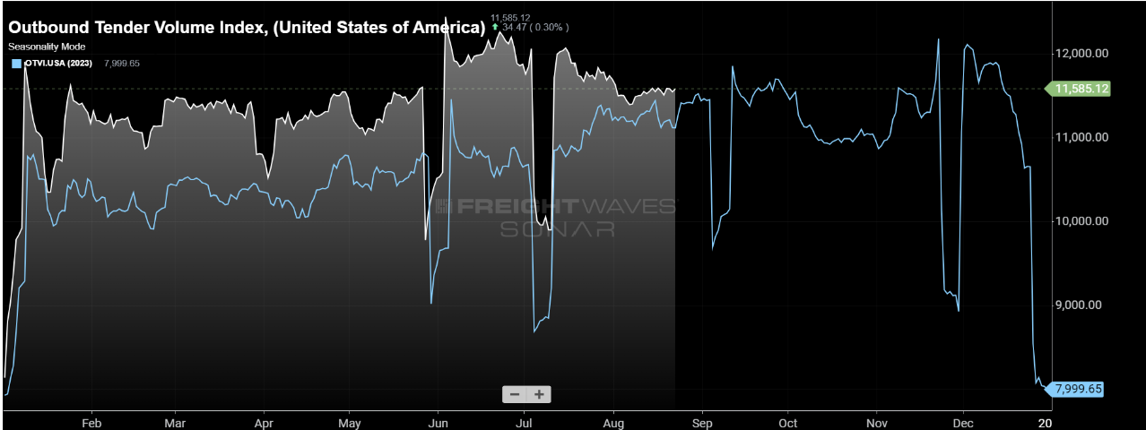


Slide 4
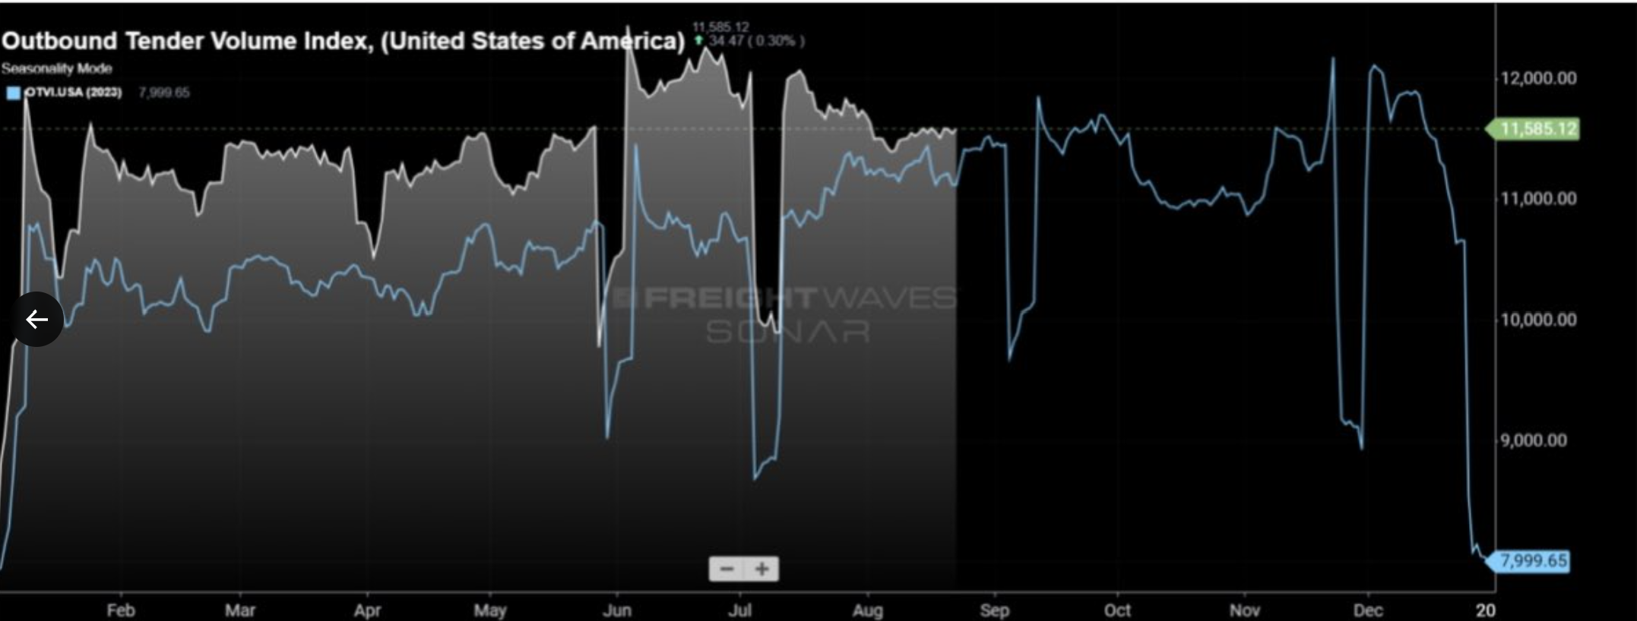
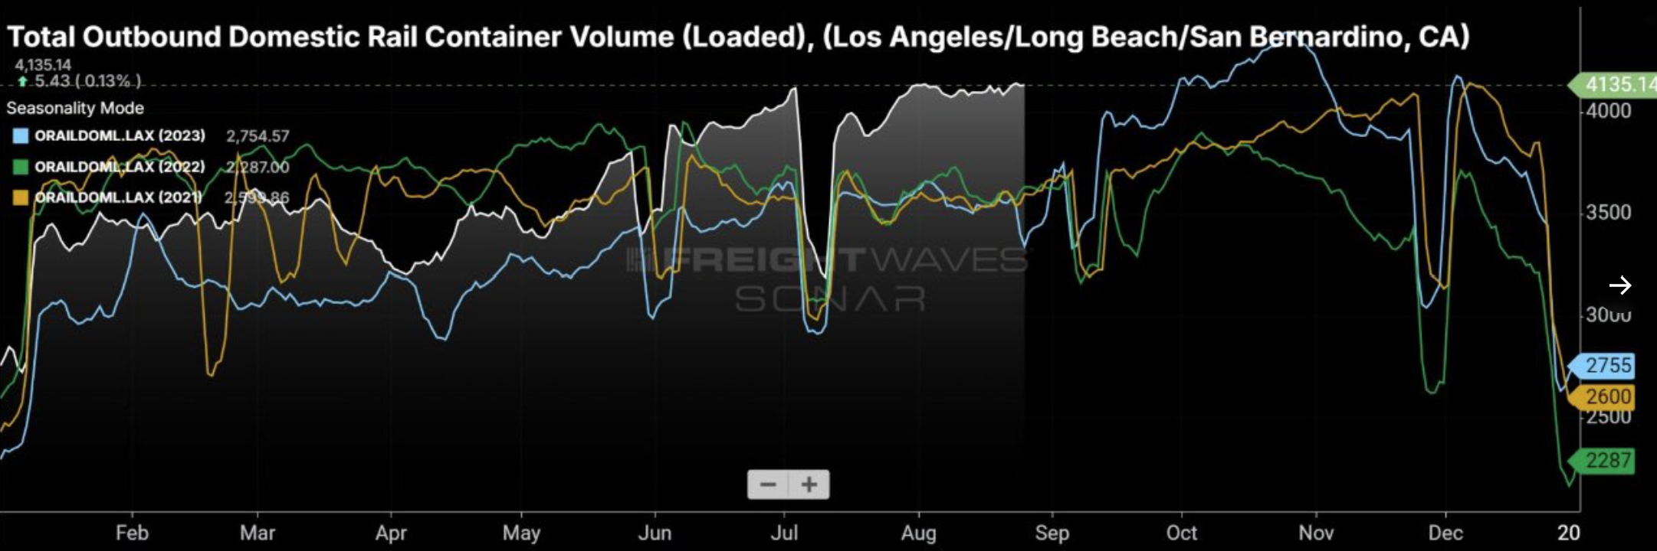

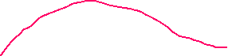

Slide 5
FTR total spot load availability falls w/w yet
Rejections fall post 4th with seasonality, yet have tabled at 5%, dovetailing from 2019 and much higher than 2023.
Van L:T ratios fall w/w yet are at 4:1 going into EOM. This is the 3rd highest read since 2016 for the week. Volumes were 13% higher y/y, a 7 year high outside 20-21.

Slide 6
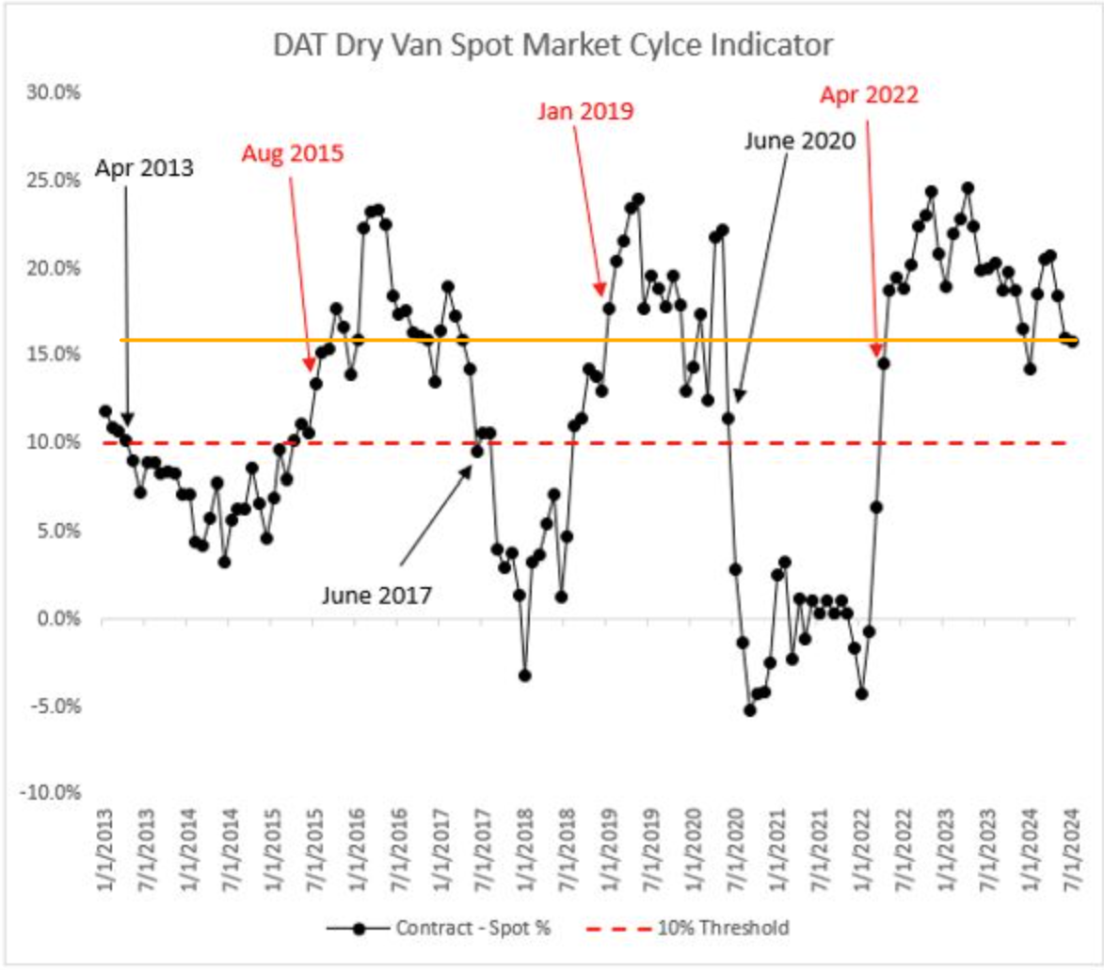
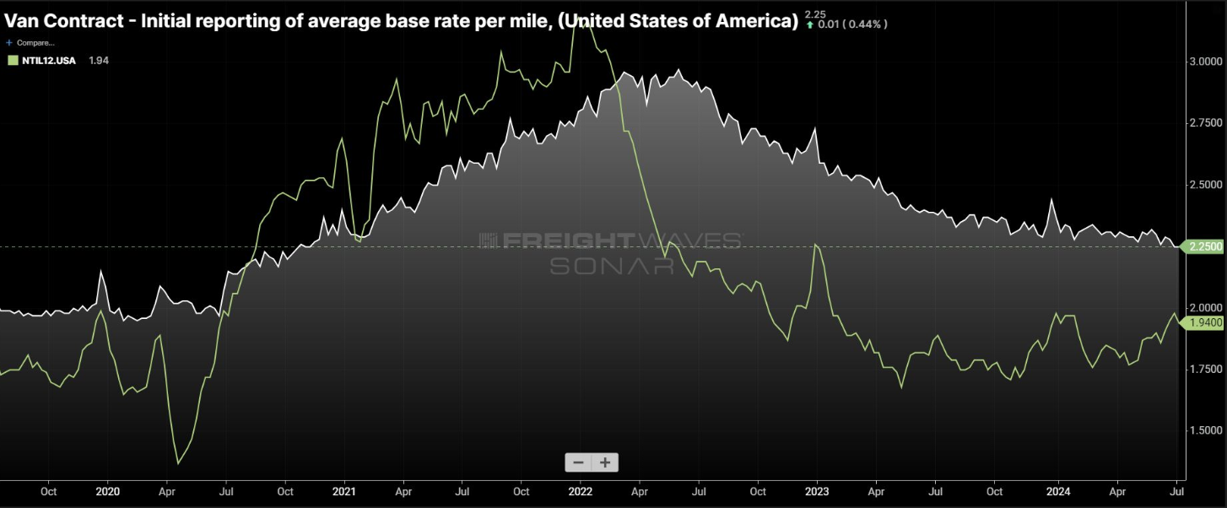
RATE ACTIVITY
The cycle indicator Eric Williams of Target first introduced, a premium of contract to spot/contract blend model moves to 15.8%. This remains above the 10% threshold for more official inflection.
The premium is at late cycle levels seen in 2017 and 2020.
FreightWaves all-in spot rates are within 31 cents of contract ex-fuel. Although spot is lower than January highs, the spread has closed.
Further convergence only exacerbates rejections.

Slide 7
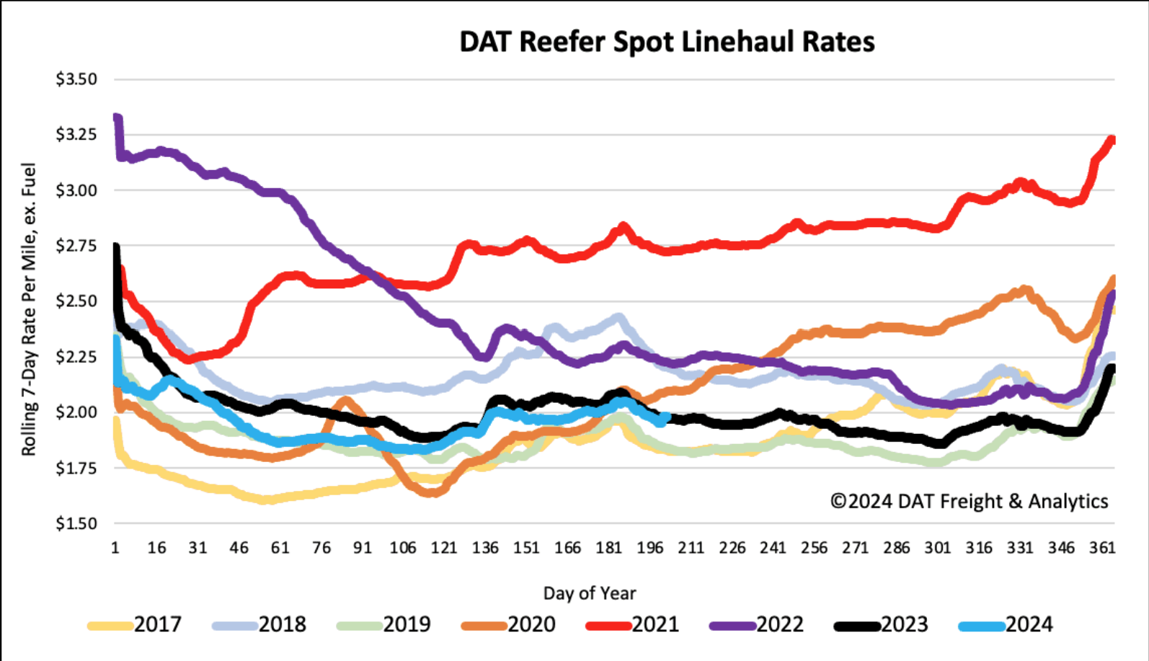
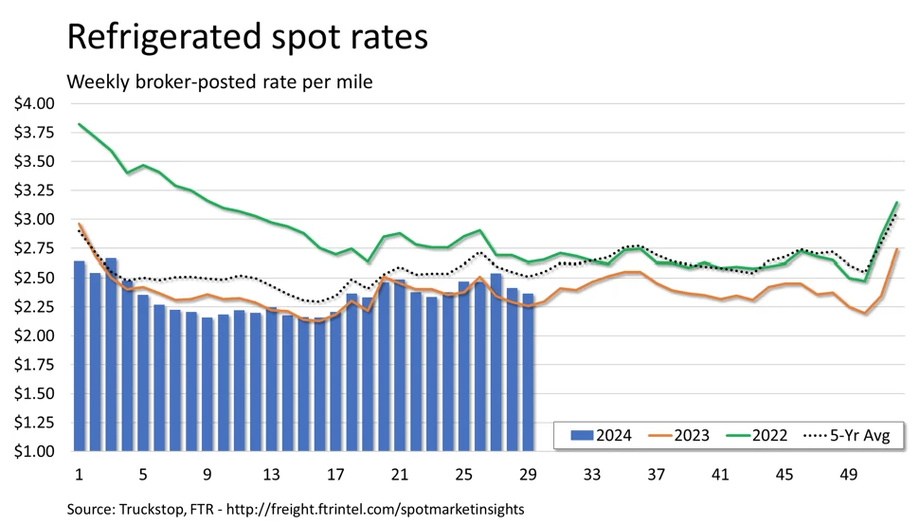
Reefer rates take their customary decline into the end of July. Fuel composition keeps linehauls closer to 2023 while all-in rates from FTR show higher y/y for the last 4 of 5 weeks.
Expect a lull through early August. California yields were lower last week yet IL/IA corn crops are the biggest in years. Post Labor Day momentum will signify how hardy a recovery is brewing or not.

Slide 8
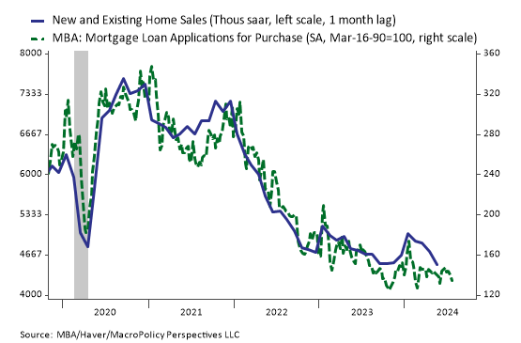
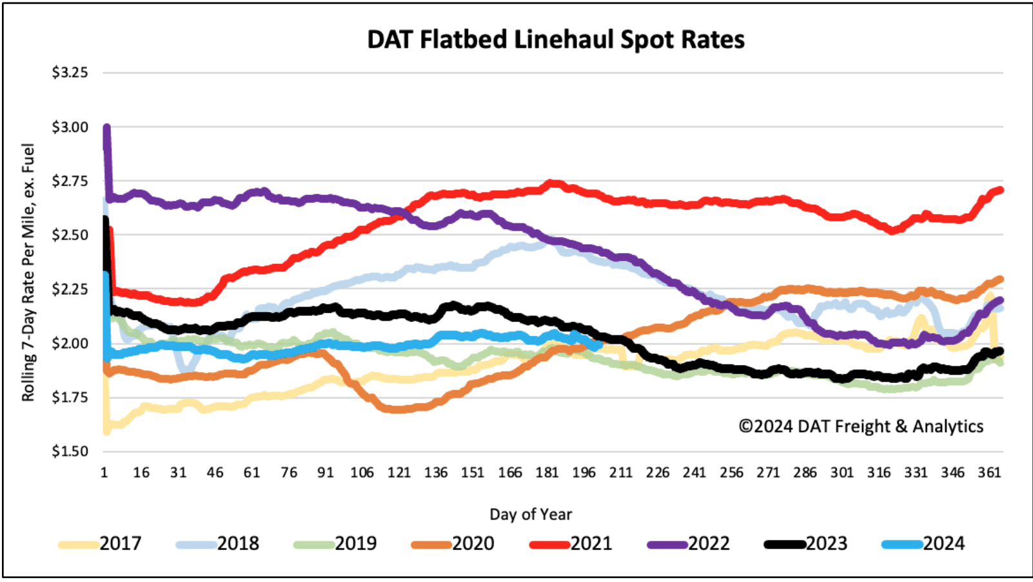
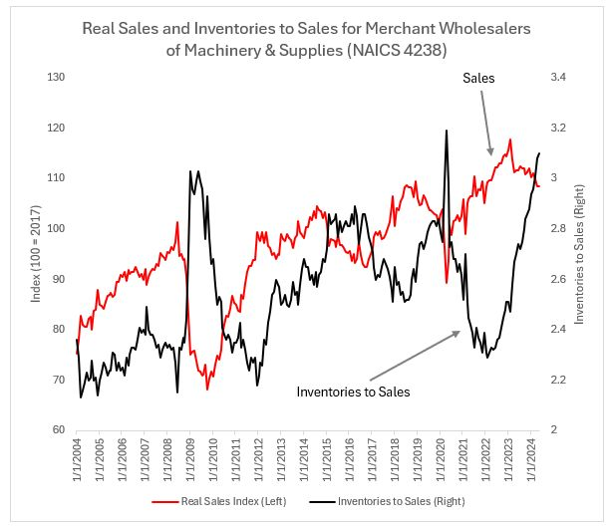
Source: Jason Miller
Source: Julia Coronado
Flatbed was the only one to lift in pressures last week, nonetheless, it faces mounting headwinds through Q3.
Housing starts, contracts, and app installs are down.
Heavy equipment manufacturers John Deere and Case New Holland Industrial are moving some operations to MX while overall machinery sales slow further.

Slide 9
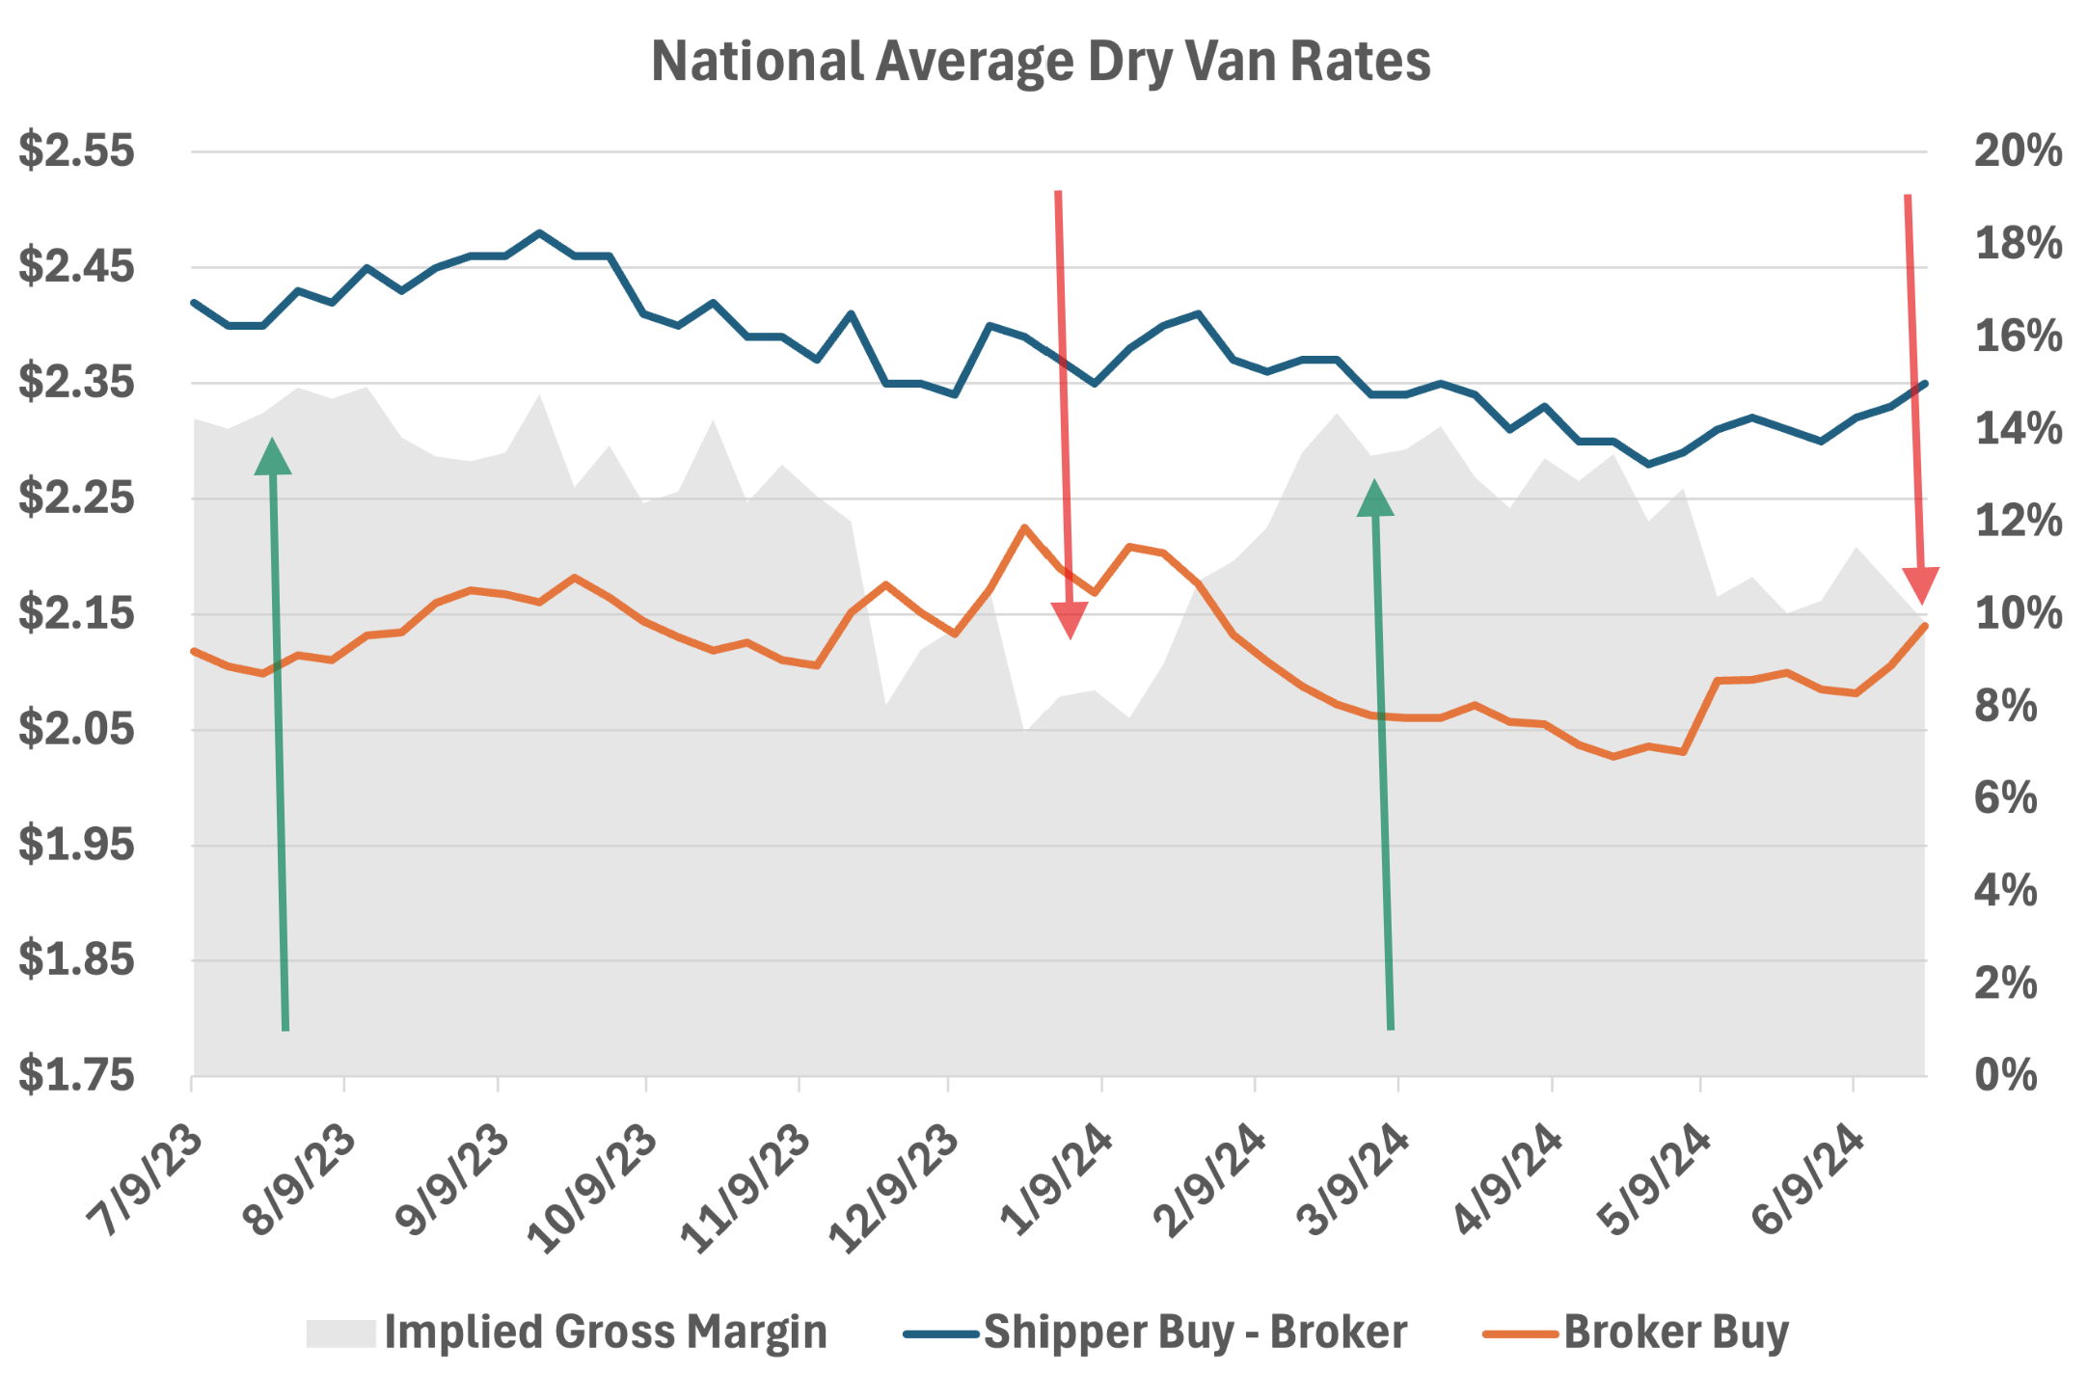
The crunch
DAT’s Ken Adamo shares shipper and broker buy patterns with implied margins.
Pricing pressures are a catch-22 for many. Higher spot rates compress margins at first.
LONGer hauls will build into labor day, giving some relief through early august.

Slide 10

Multi-modal

Slide 11
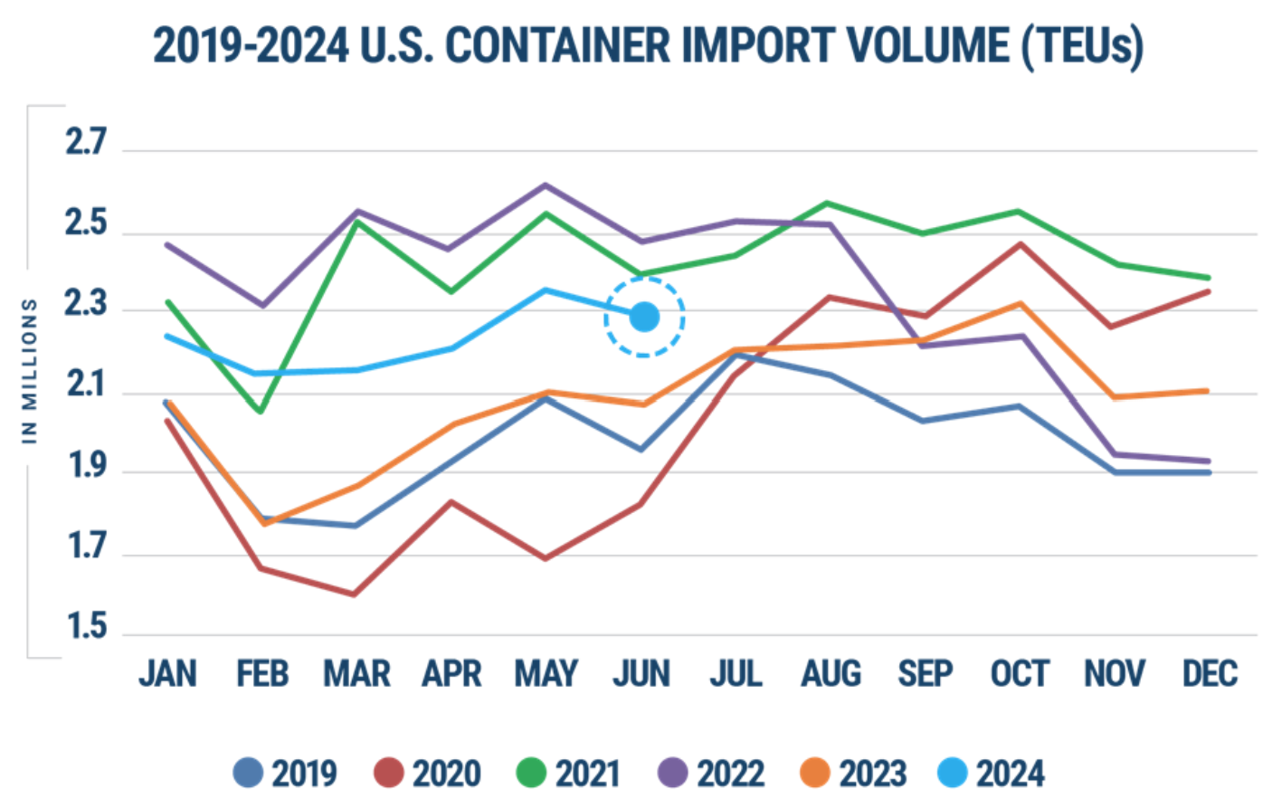
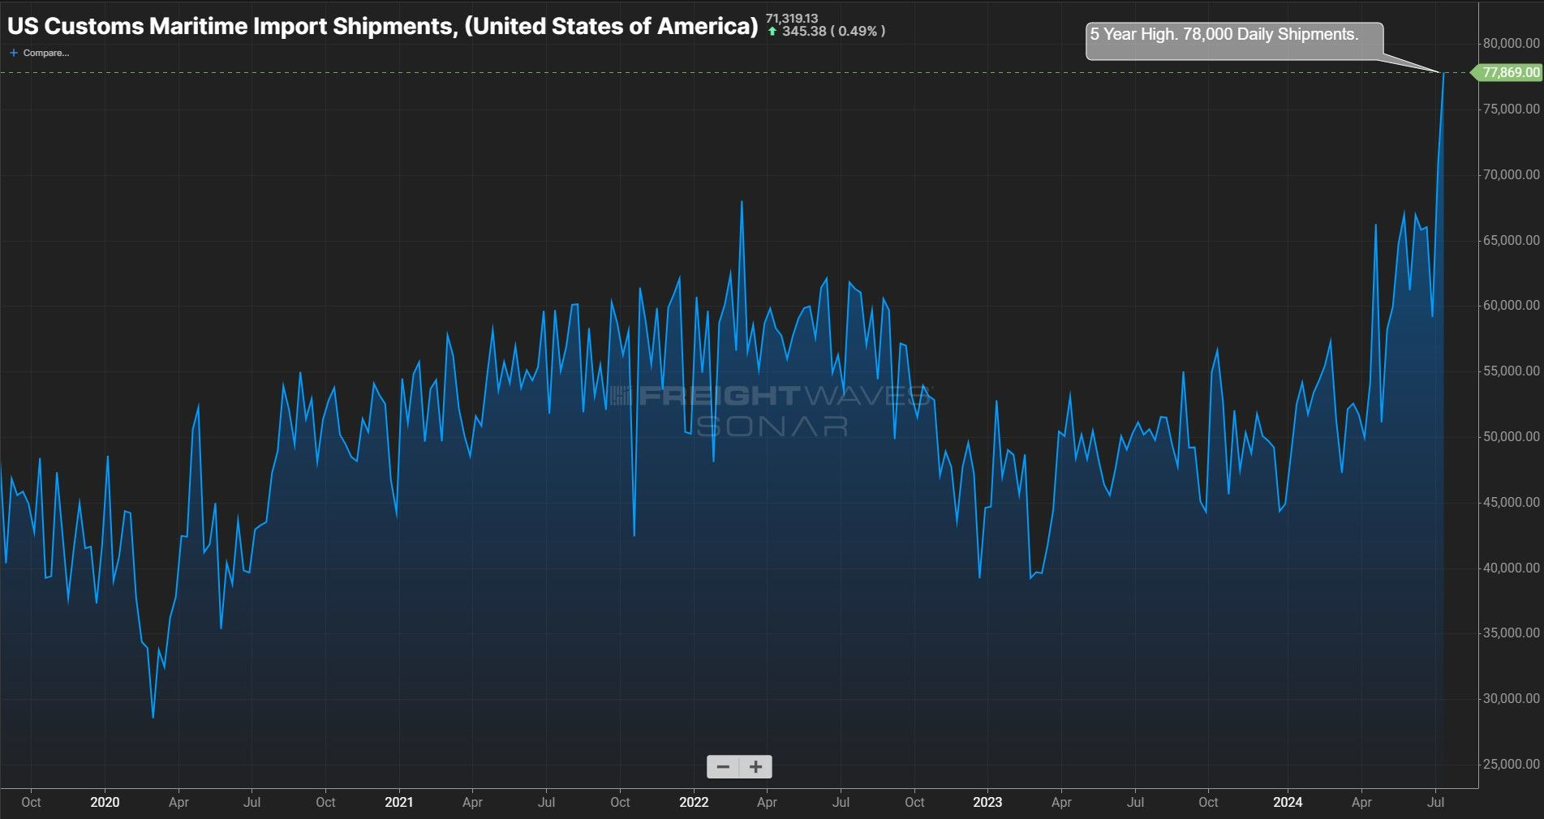
June import gains shrink to 10% y/y while Chinese imports rise 14%.
July daily maritime customs shipments fly to 5-year highs.

Slide 12
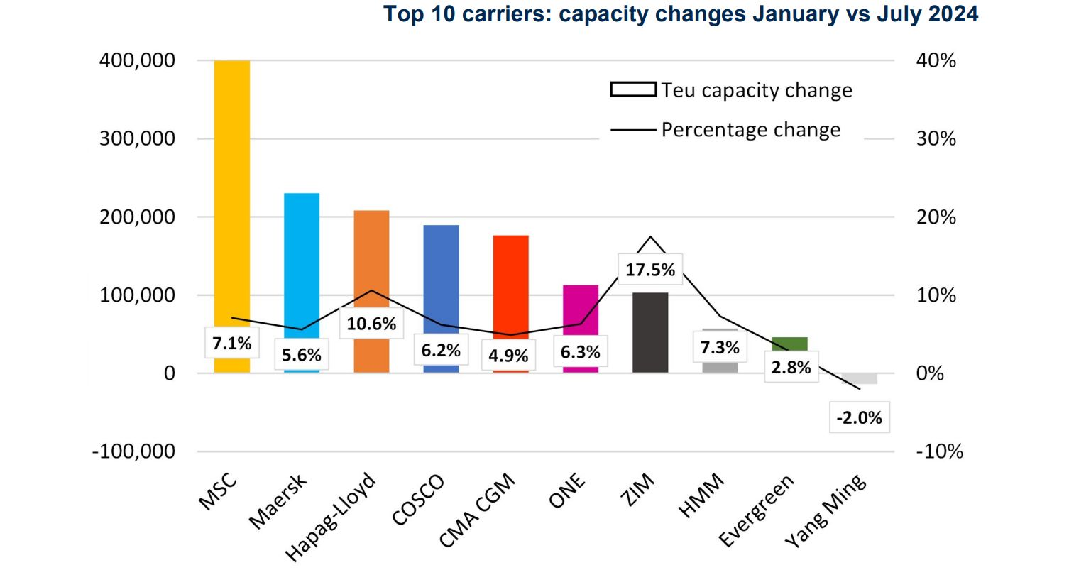
Msc leads in total capacity gains in 2024
Source: Alphaliner
Crafted by Beau King

Slide 13
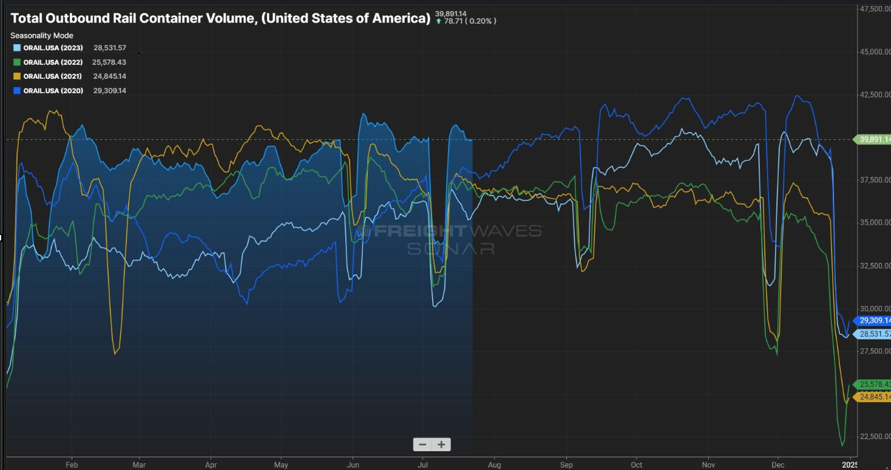
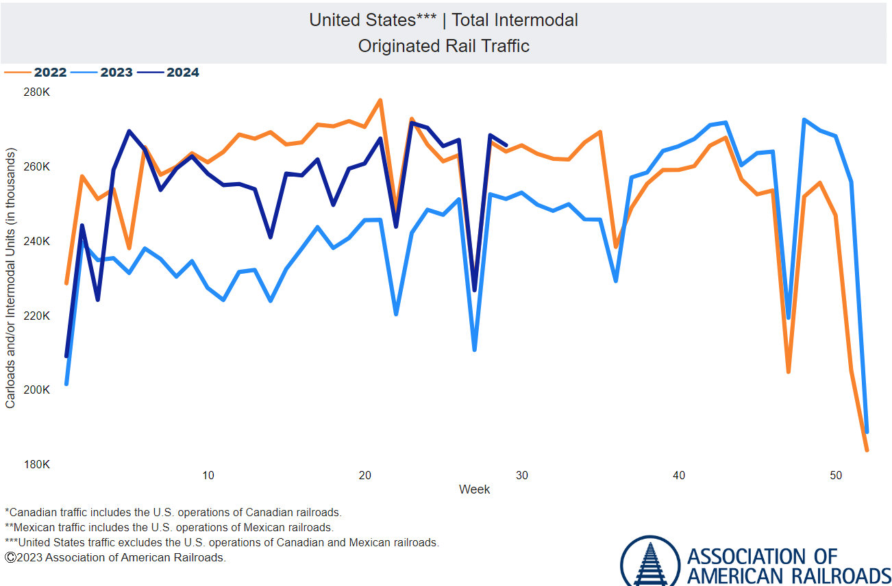
International rail keeps hummin’ from imports
Domestic rail has softer incremental volume. Prices offset momentum.

Slide 14
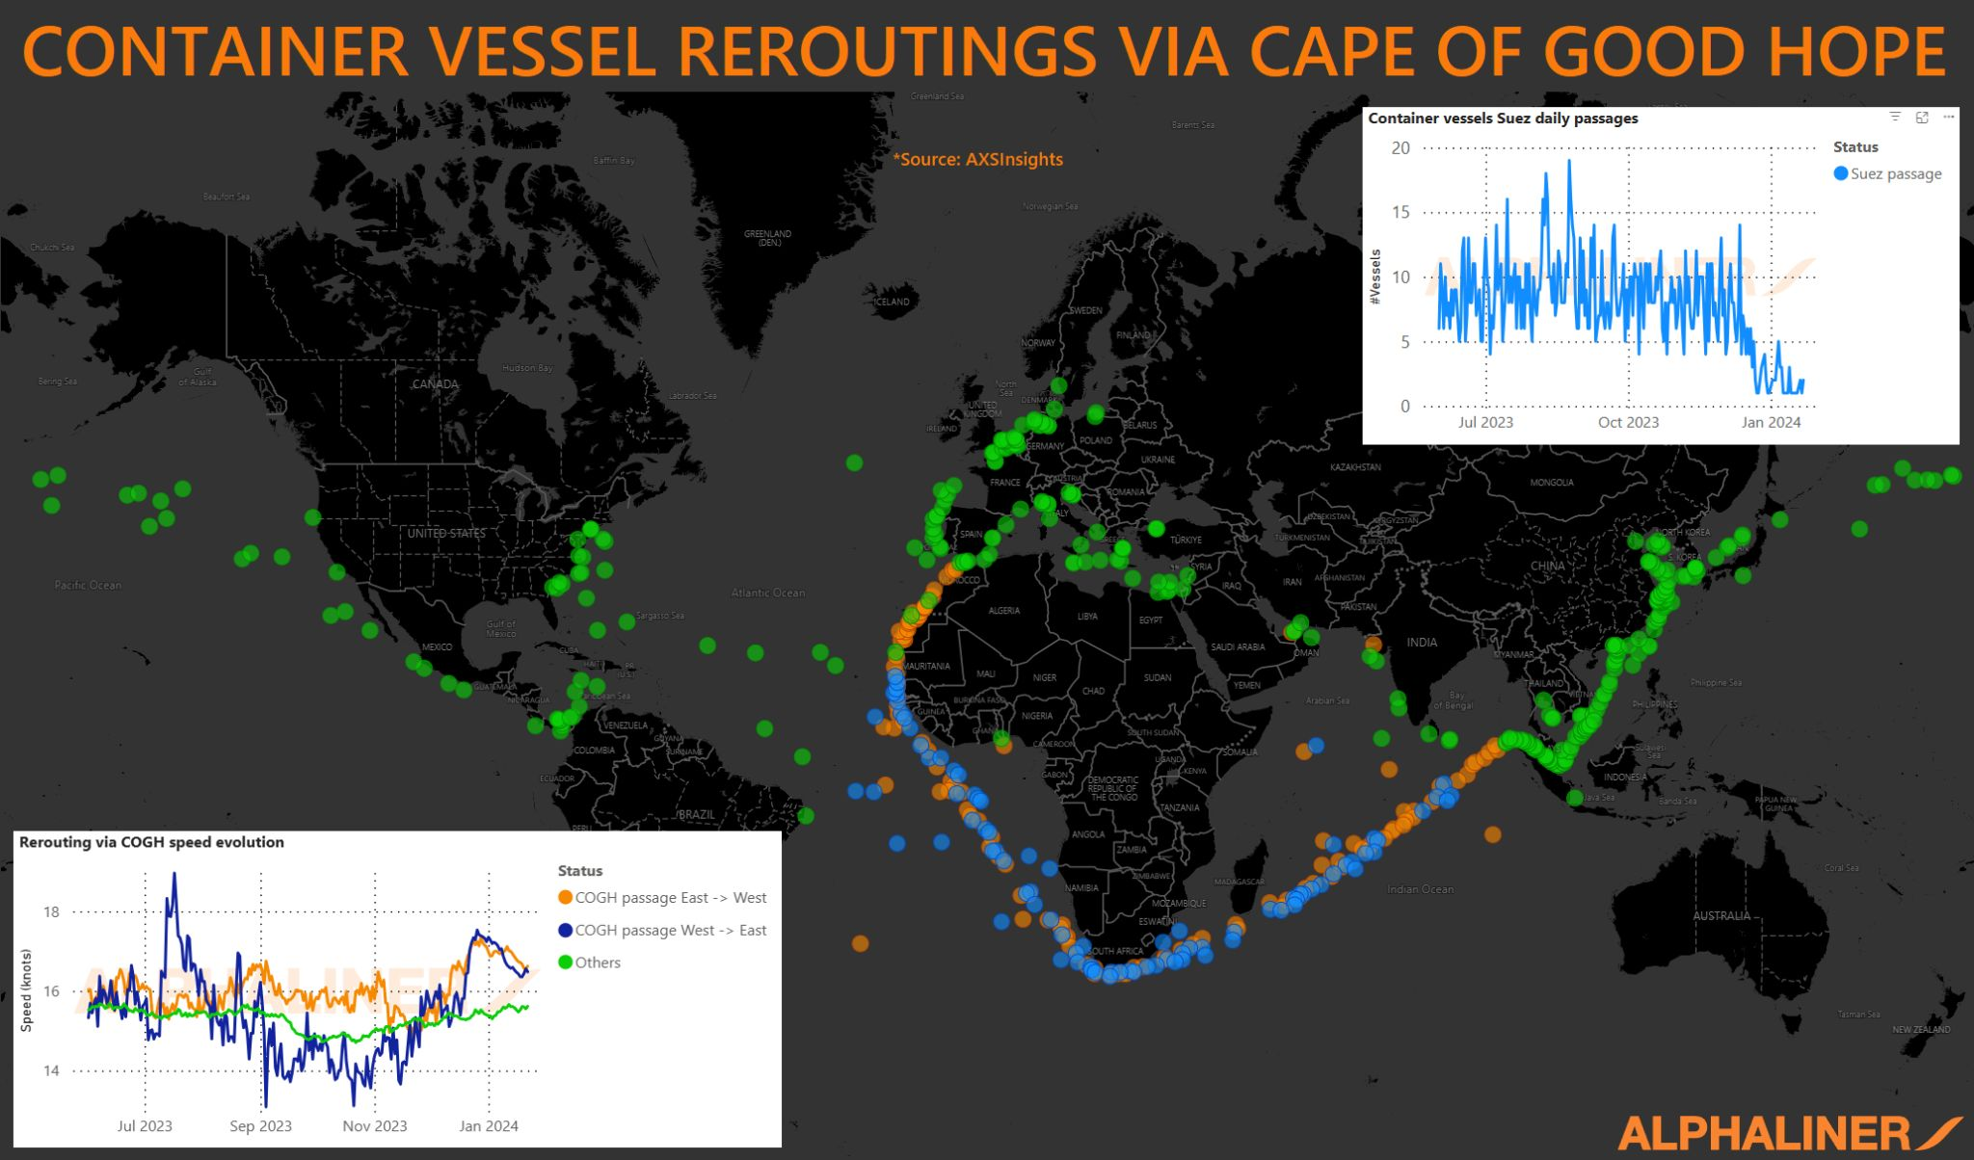
30% of traffic

Slide 15
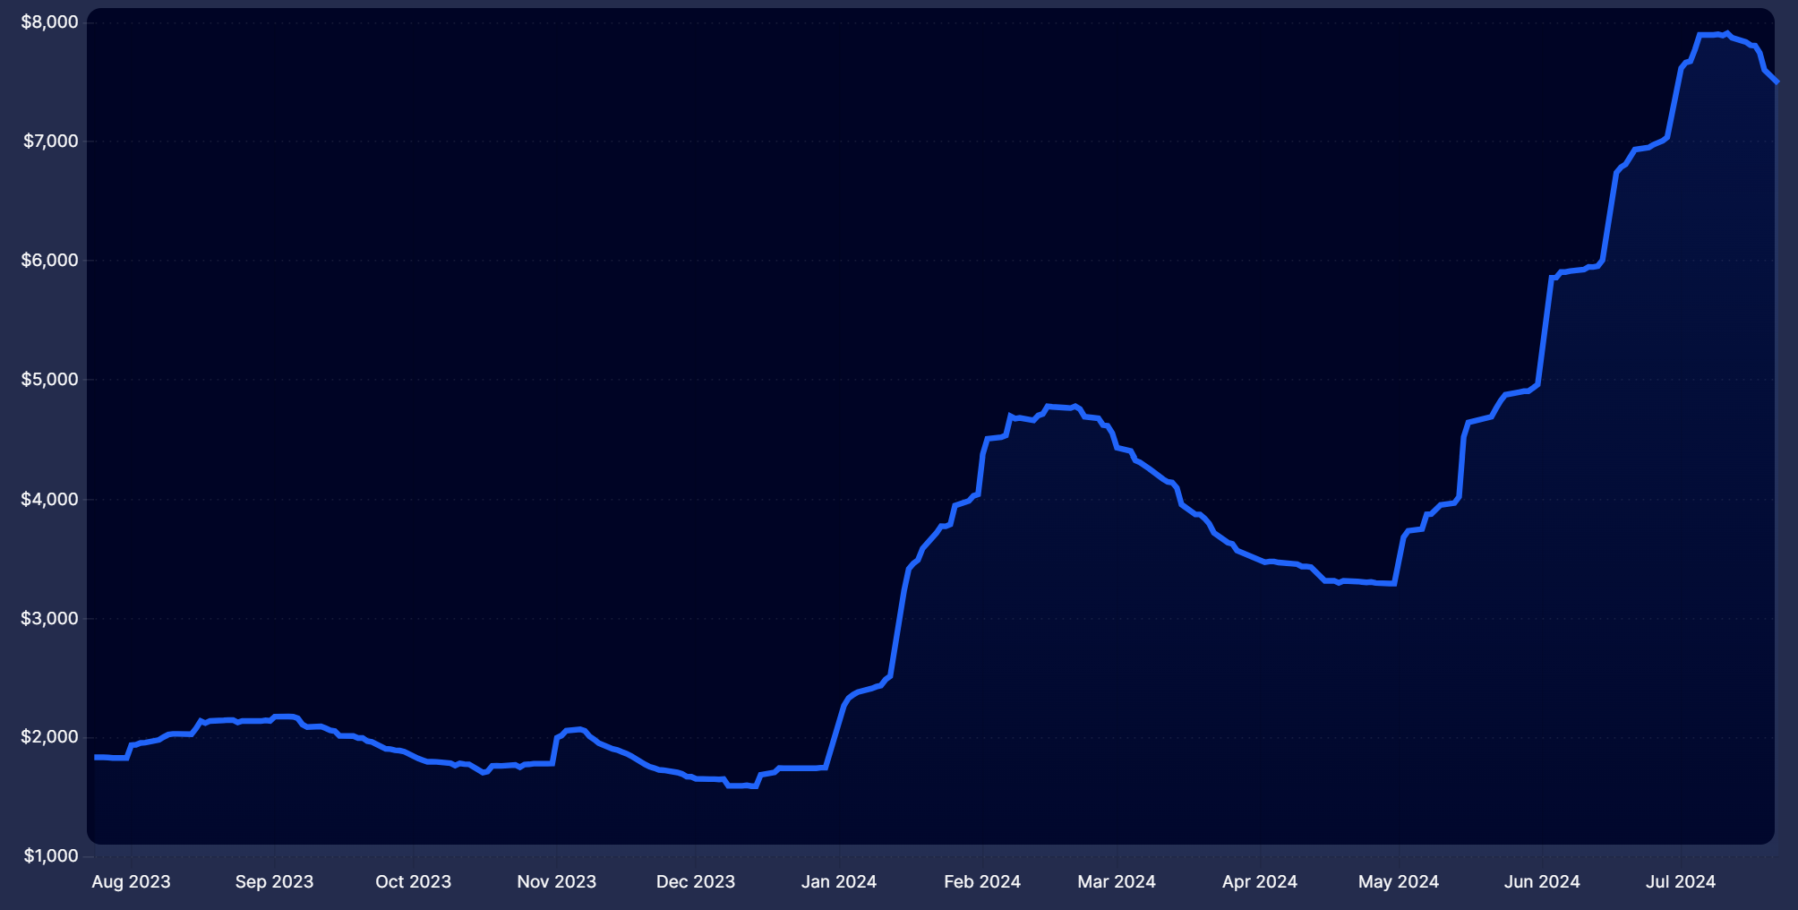

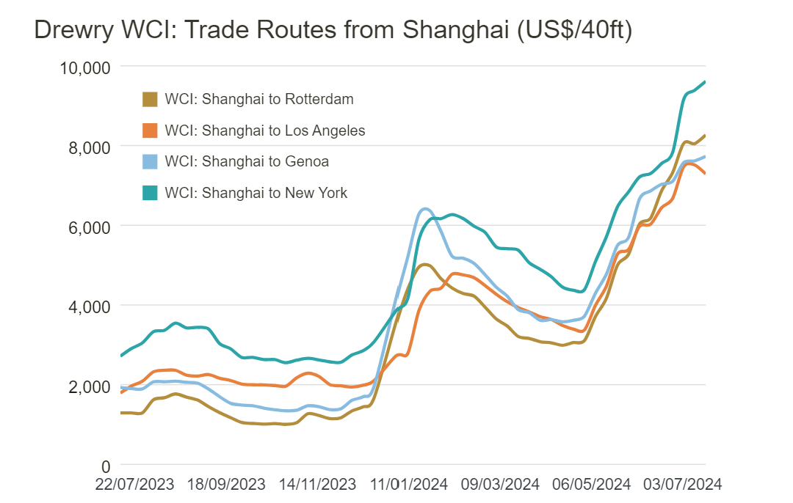
Chinese container rates stabilize in July while leasing increases.
Consensus has built around frontloading ahead of tariff schedules and the election.
Xeneta and Drewry show softening in Transpacific routing in July.
If high levels of demand continue, expect some resurgence by September. If fully pulled forward, softening may continue until Q1 2025 orders start in November.
East Coast routings have not yet abated as discussions stall

Slide 16
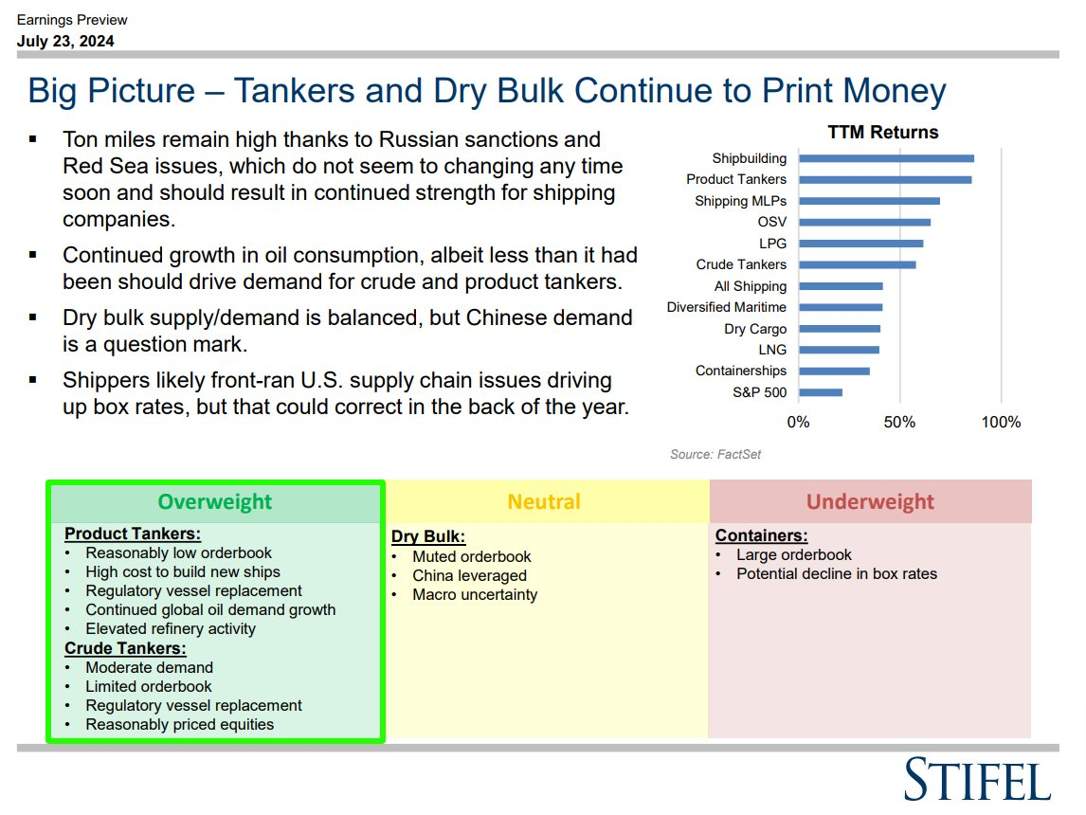
It’s more than just boxes
Source: X| Edward Finley-Richardson

Slide 17

eyeing ahead

Slide 18

For all the momentum in domestic transportation, there is a growing crowd insisting an interest rate cut as soft data builds, including former NY Fed Bank President Bill Dudley. The meeting next week will be pivotal.
Most indicators show seasonal patterns for pricing pressures slowing into August; however, levels are dovetailing from 2019 and 2023 for Van and Reefer.
The Philadelphia Reserve Bank shows promising regional activity while the flash S&P Global Flash US PMI shows services leading the way.
Input/output prices are down for manufacturing, yet production and new orders have contracted.

